Slide 1
Visual Summarization of Stories
Notes:
Zhiheng

Slide 2
Background
When we read a sentence,
We impose a linear order on the words in the sentence
Difficult to understand for some people
Time consuming
Difficult for analysis of text and pattern finding

Slide 3
Analyse relationships between characters in a story using a summary network
Notes:
Goal

Slide 4
Network
Dan
Ben
Adam
Cindy

Slide 5
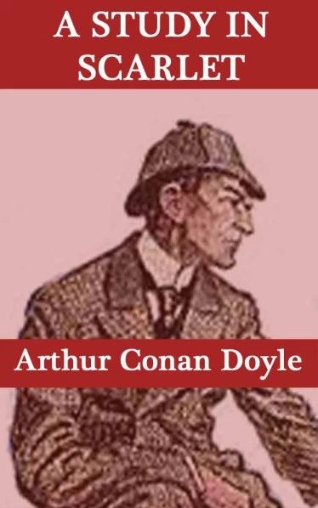


Data

Slide 6


Network summarization!

Slide 7
Why a network?
Offers a different perspective to understand relatively complex stories
Introduce the idea of agents and patients to understand a story better
Identify patterns in the plots of the stories
Existing summarization methods such as topic modelling are limited in capability

Slide 8

Similar Research
Fernandez, M., Peterson, M., & Ulmer, B. (December 7, 2015). Extracting Social Network from Literature to Predict Antagonist and Protagonist. Retrieved March 25, 2018, from https://nlp.stanford.edu/courses/cs224n/2015/reports/14.pdf.
A social network of 5 fairy tales to find protagonist and antagonist

Slide 9
Limitations
Aim of the research was to identify protagonist and antagonist
Only compared positive and negative relationships
Only used on fairy tales which are relatively simple
Failing to identify some of the characters

Slide 10
Agency
Agents
Patients
Actively changing the story
Carries out actions
Passive and waits to be changed
Actions are acted upon them
Noun + Verb
Verb + Noun

Slide 11
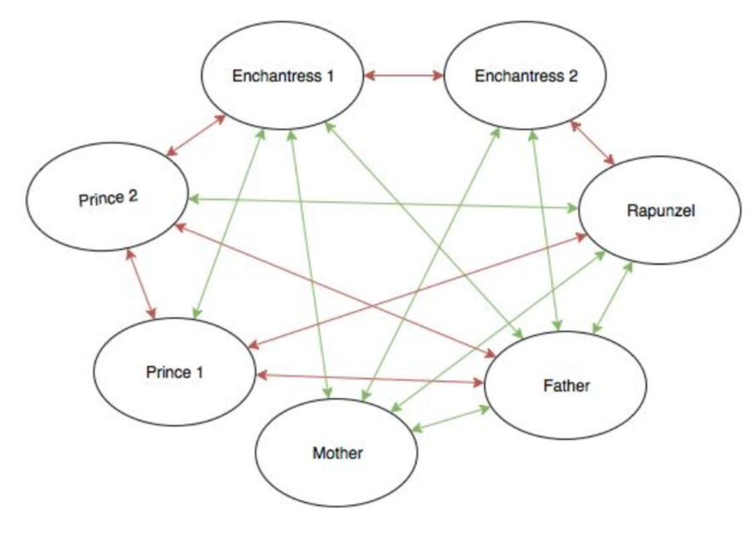
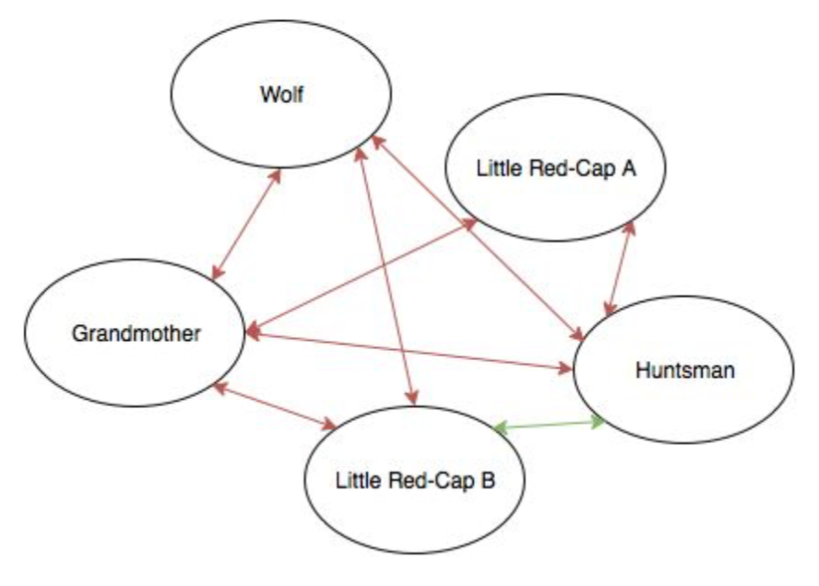
ABOVE: Graphs adapted from research paper, which are unweighted, and only determine polarity of sentiment

Slide 12
Solution Design

Slide 13
Word Tagging
Sherlock
Proper Noun
Holmes
Proper Noun
went
Verb
home
Noun

Slide 14
Word Tagging
Sherlock Holmes
Proper Noun
went
Verb
home
Noun

Slide 15
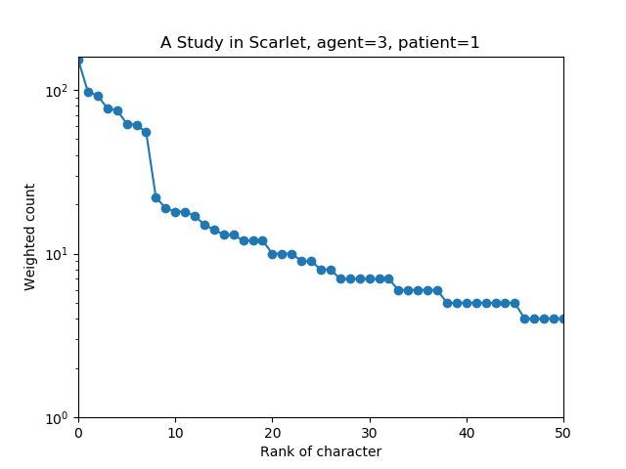
Identification of key entities
Main characters
Sharp drop in frequency
Less important characters
Log-y Graph of frequency count of characters, after giving agents weight 3, patients weight 1

Slide 16
Disambiguation
Holmes
Mr Holmes
Sherlock Holmes
Sherlock
Sherlock Holmes
He
Him
His

Slide 17
Character Nodes
Dan
Ben
Adam
Cindy

Slide 18
Unweighted Undirected Network
Dan
Ben
Adam
Cindy

Slide 19
Unweighted Directed Network
Dan
Ben
Adam
Cindy

Slide 20
Weighted Directed Network
Dan
Ben
Adam
Cindy

Slide 21
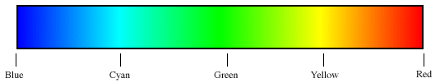
Coloured Weighted Directed Network using Sentiment Analysis
Dan
Ben
Adam
Cindy
Positive
Negative
Notes:
Valence Aware Dictionary and sEntiment Reasoner

Slide 22
Planar Maximally Filtered Graph
Planar graph
Non-planar graph

Slide 23
Planar Maximally Filtered Graph

Slide 24
Planar Maximally Filtered Graph

Slide 25
Error Analysis
Identification of characters
Proper nouns 100%
Pronouns 76%
Succeeding in identify characters 94%

Slide 26
Results
Notes:
Live Demonstration with Gephi

Slide 27
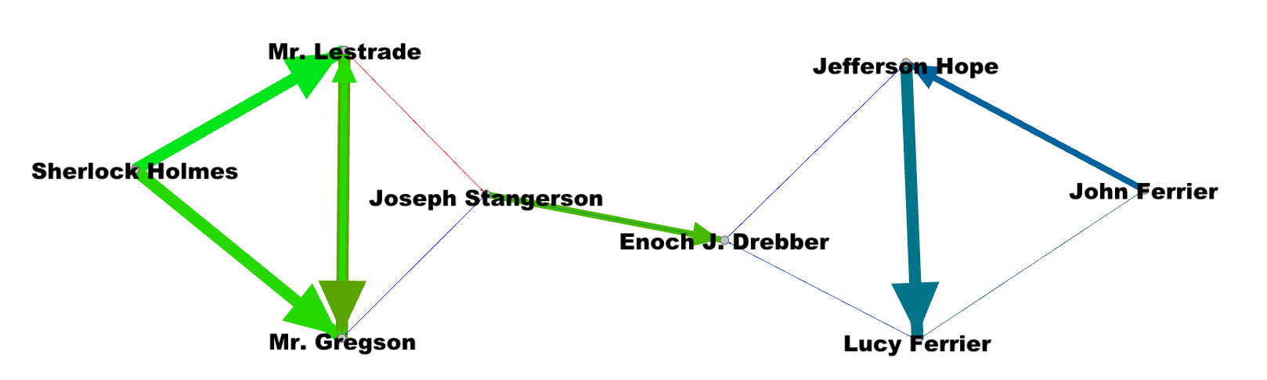
A Study in Scarlet
Murderer
Triangular Neighbourhoods
Victims

Slide 28
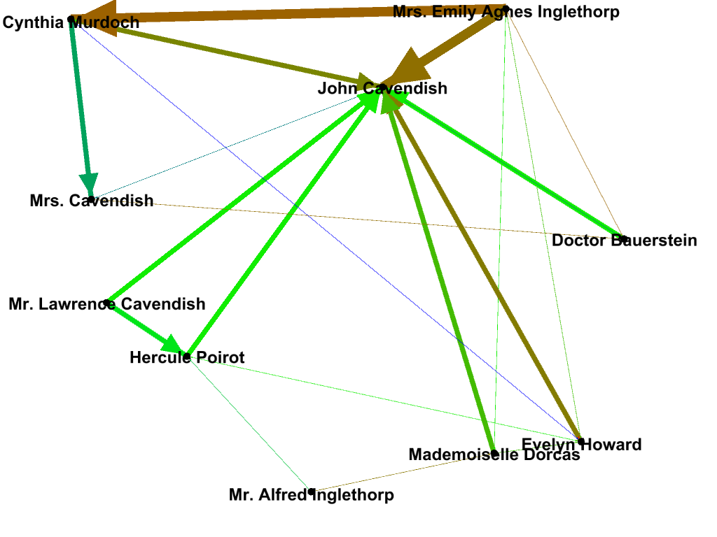
The Mysterious Affair at Styles
Central Character
Triangular Neighbourhoods
Murderer

Slide 29
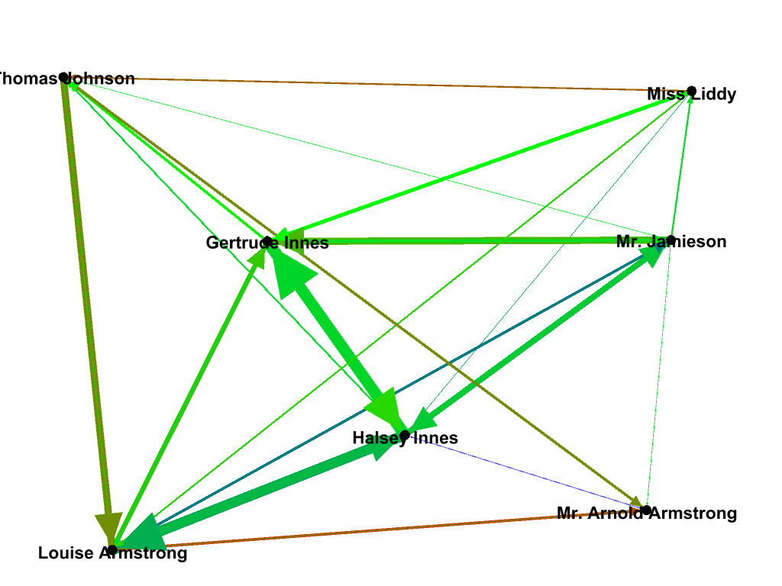
The Circular Staircase (Non-Planar)

Slide 30
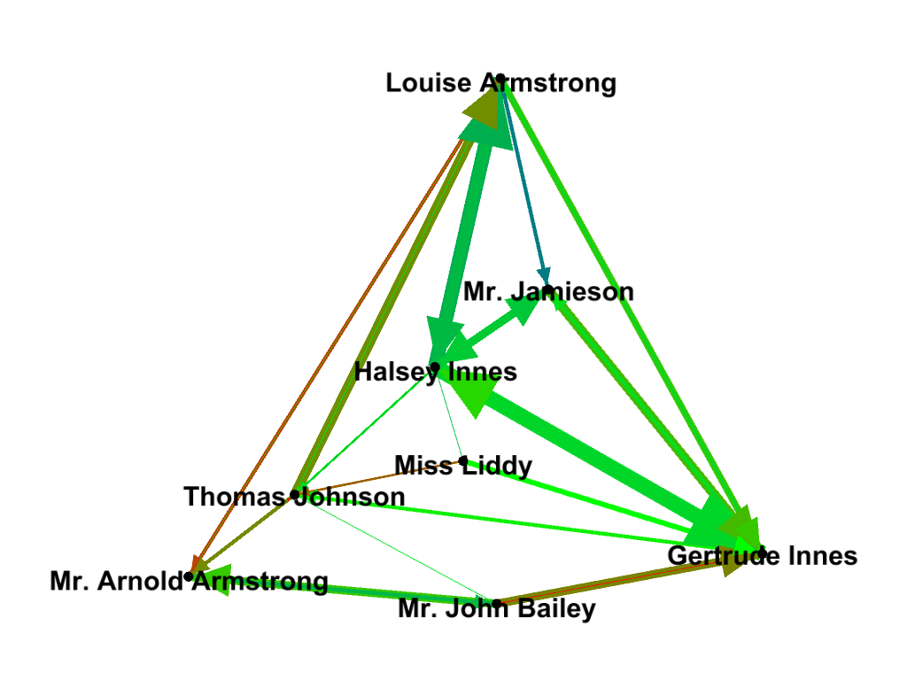
The Circular Staircase (Planar)
4 character network neighbourhood

Slide 31
Further Work
More accurate disambiguation
Increased automation
Can be used in
News Analysis
Literature research

Slide 32
A picture is worth a thousand words.

Slide 33
Image References
Slide 4 images:
Master of Art in Museum Studies & Curatorial Practices. (n.d.). Retrieved March 24, 2018, from https://blogs.ntu.edu.sg/mscp/
Science Centre Singapore (n.d.). Retrieved March 24, 2018, from http://www.science.edu.sg/aboutus/Pages/awardsachievements.aspx
Slide 7 images:
A Study in Scarlet – Free Online Text. (2012, August 27). Retrieved March 25, 2018, from https://sherlockholmes22b.wordpress.com/sherlock-holmes-ebooks/a-study-in-scarlet/a-study-in-scarlet-free-online-text/
Rinehart, M. R., Clouds, C., Derus, R., S., J., C., . . . MTK. (n.d.). The Circular Staircase. Retrieved March 25, 2018, from https://www.goodreads.com/book/show/994823.The_Circular_Staircase
The Mysterious Affair at Styles. (n.d.). Retrieved March 25, 2018, from http://www.agathachristie.com/stories/the-mysterious-affair-at-styles
Notes:
Junwei

Slide 34
Image References
Slide 8 images:
Hattersley, L. (2017, January 27). Learn how to code on a Mac with Python. Retrieved March 24, 2018, from https://www.macworld.co.uk/how-to/mac/coding-with-python-on-mac-3635912/
Levallois, C. (n.d.). Converting a network with dates into a dynamic network. Retrieved March 24, 2018, from https://seinecle.github.io/gephi-tutorials/generated-html/converting-a-network-with-dates-into-dynamic.html
Natural Language Processing with Python NLTK Training. (n.d.). Retrieved March 28, 2018, from https://www.tertiarycourses.com.sg/natural-language-processing-nlp-nltk.html
Slides 9-10 images:
Stanford NLP. (n.d.). Retrieved from https://github.com/stanfordnlp
Slide 11 images:
Krebs, Valdis & Holley, June. (2004). Building sustainable communities through social network development. The Nonprofit Quarterly. 11. 46-53. Retrieved from https://www.researchgate.net/publication/288029178_Building_sustainable_communities_through_social_network_development
Notes:
Junwei

Slide 35
Thank you

Slide 36
Any questions?

Slide 37
Appendix

Slide 38
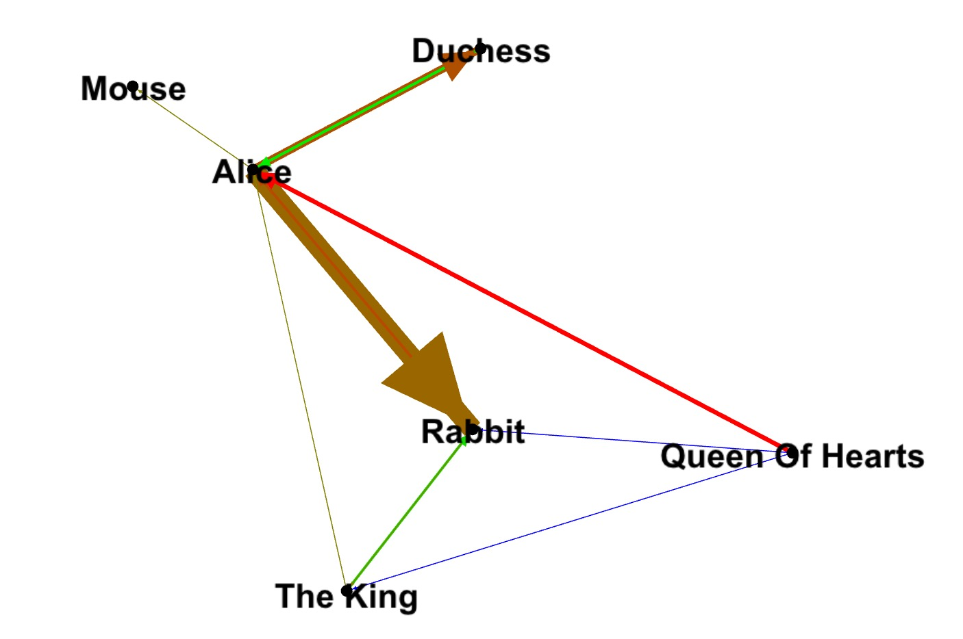
Notes:
The Duchess approaches Alice and attempts to befriend her, but the Duchess makes Alice feel uneasy.
http://www.sparknotes.com/lit/alice/summary/

Slide 39
